Slide 1

MACHINE LEARNING DETECTION OF FOREST FIRES
Nile Coble Weekly Review

Slide 2
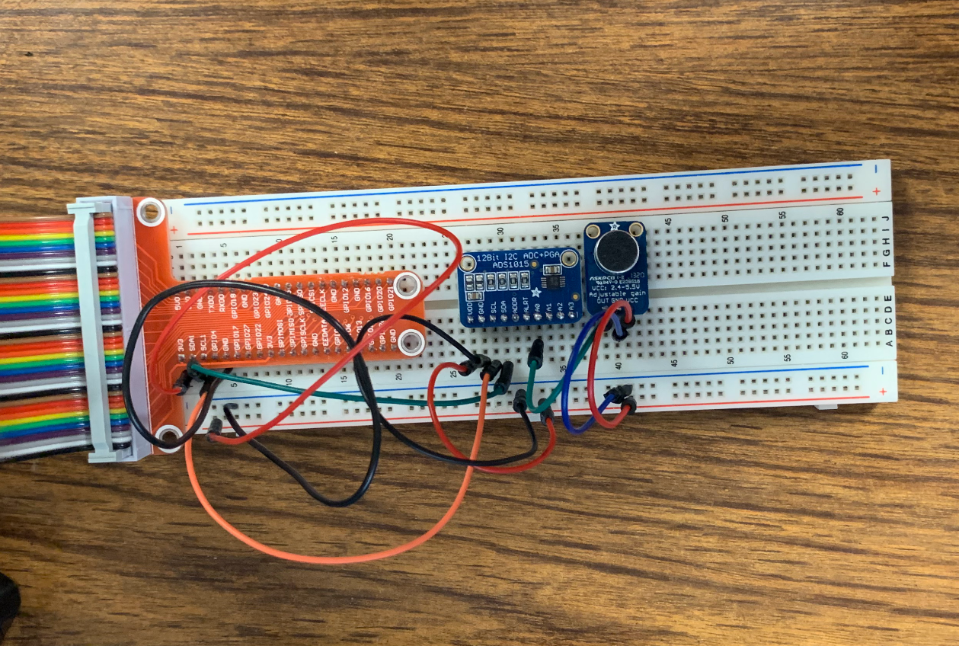
Better microphone
RPi can now perform all data processing short of running the model

Slide 3
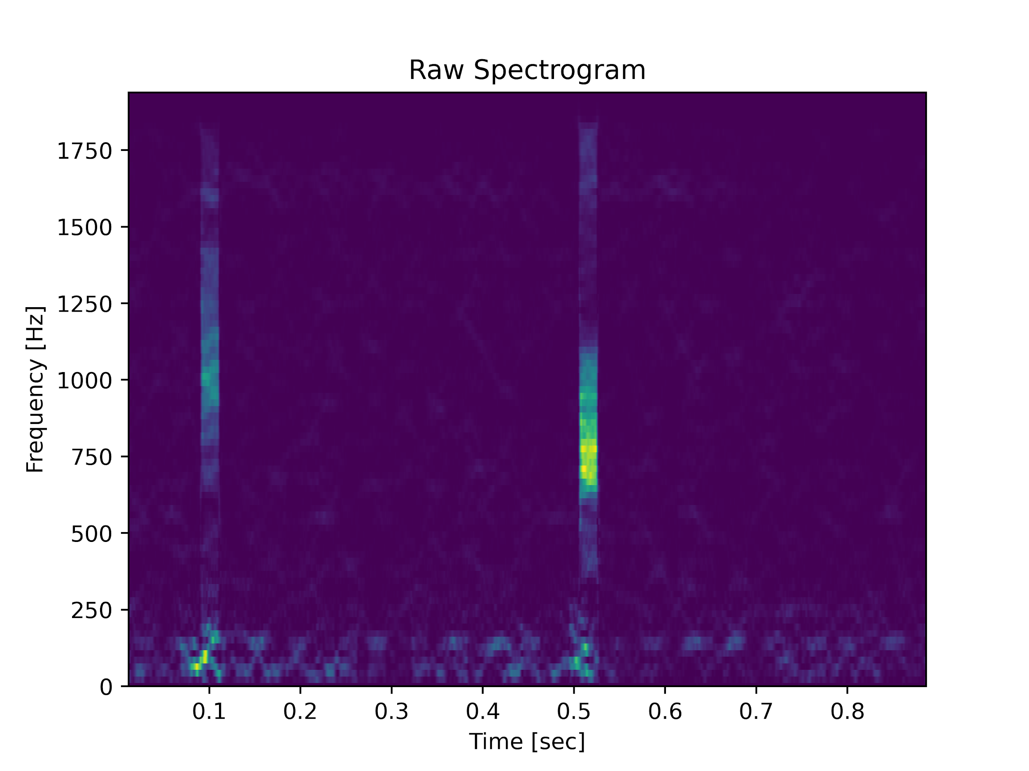
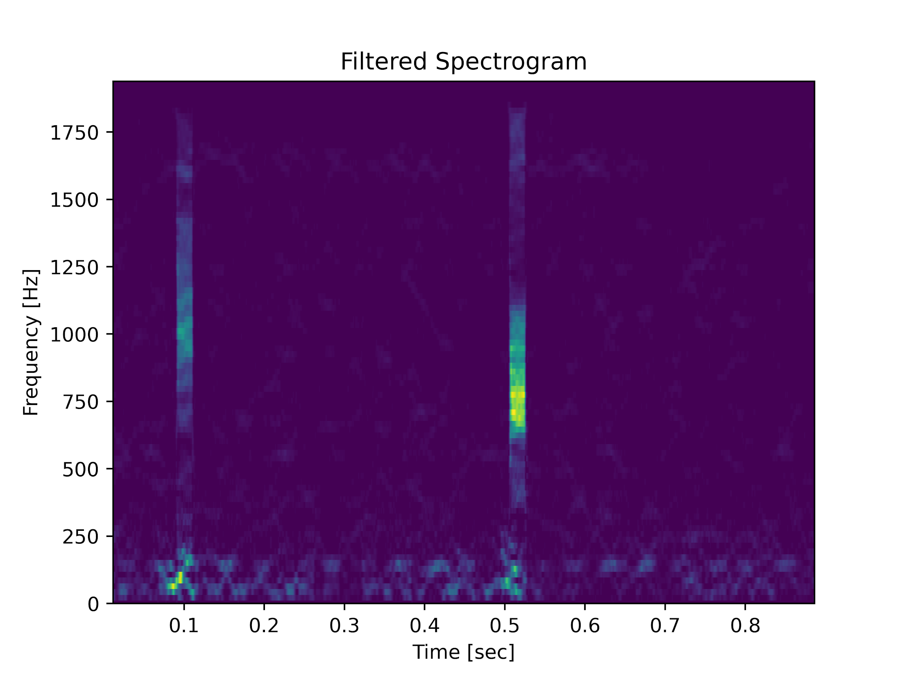
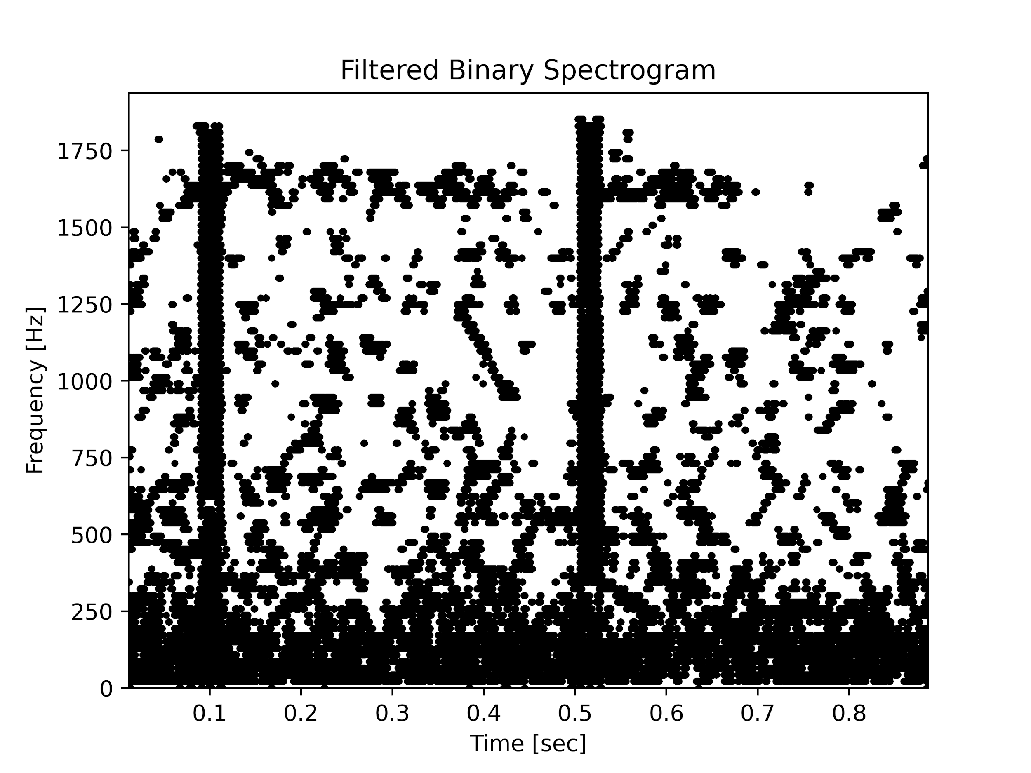
Next Up:
Create main program that will run during deployment
Threading for real-time performance

Slide 4
THANK YOU

